Slide 1
PSYCHOLOGY OF PERSONALITY
Psychologists generally define Personality as:
“the characteristic ways of Feeling, Acting and Thinking, that make a person “an individual”

Slide 2
Personality
The Psychology of Personality
Personality theories:
trait theories—McCrae and Costa (p.237)
humanistic theories—Rogers, Maslow (p.239 - 240)
Personality: (p. 238-239)
continuity over time
consistency across situations.
Contemporary type theories and uses – health; business (Myers-Briggs) (pp 240- 242)
The Psychology of Personality
Contributions and limitations of personality theories:
trait theories - McCrae and Costa (p.237)
humanistic theories—Rogers, Maslow. (p.239-240)

Slide 3
Trait Approach
Humanistic Approach
Social Cognitive approach
Traits:
are stable over time,
differ among individuals
are bipolar
influence behavior
Key aspects
Free will
Humans are innately good
Humans are motivated to reach their full potential
Key aspects
Critical of trait approach
Personality is shaped by interaction of person with their environment
Mcrae and Costa’s Big Five
OCEAN
Openness to experience
Conscientiousness
Extraversion
Agreeableness
Neuroticism
Consistency and continuity of traits
Rank order stability
Mean level consistency
Individual continuity
Maslow
Hierarchy of needs
Physiological
Safety
Belongingness and love
Esteem
Self actualisation
Bandura
Reciprocal determinism
Personal factors
Behaviour
External environment
Self efficacy
Impacted by:
Performance accomplishments
Vicarious experiences
Social persuasion
Emotional state
Low self efficacy is a risk factor for mental illnesses
Year 12 Personality theories
Rogers
When self image and ideal self match, it leads to personality congruence
Higher congruence makes it easier to self actualise
Incongruence leads to mental illness and low self worth
Fully functioning people are
Open to experience
Live existentially
Trust organismically
Have experiential freedom and are creative
Conditional and unconditional positive regard
Mischel’s cognitive and affective theory
Cognitive personal variables
Encoding
Expectancies
Affects
Goals and values
Competencies and self regulation
Marshmallow test
Self regulation often called self control

Slide 4
Theories summarised
Trait Theory – personality traits are inherited – a result of genetics; stable and long-lasting characteristics; consistent
Humanistic theories – personality develops based on our environment and people around us; “people are born good”
Psychodynamic theory – personality develops from childhood experiences – environment; take into account the situation in which the behaviour is occurring

Slide 5
the main contribution to social psychology made by Floyd Allport
He wrote about the need for social psychology to be studied scientifically
Scientific study of social psychology using a behaviourist approach
Introduction of experimental methods to the study of social psychology
He published a textbook on social psychology
He Introduced ideas (such as) social conformity / facial expression of emotions / influence of an audience on individual behaviour

Slide 6
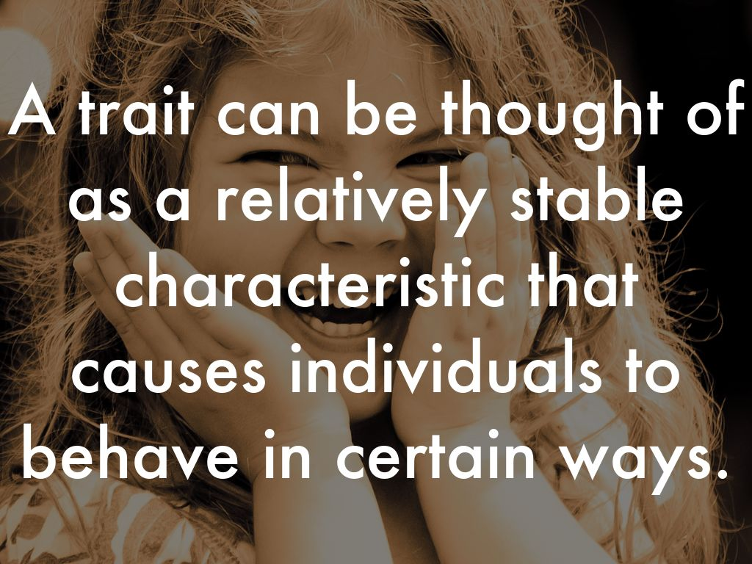
Photo by RuffLife - Creative Commons Attribution-NonCommercial-ShareAlike License https://www.flickr.com/photos/40993822@N06
Created with Haiku Deck

Slide 7
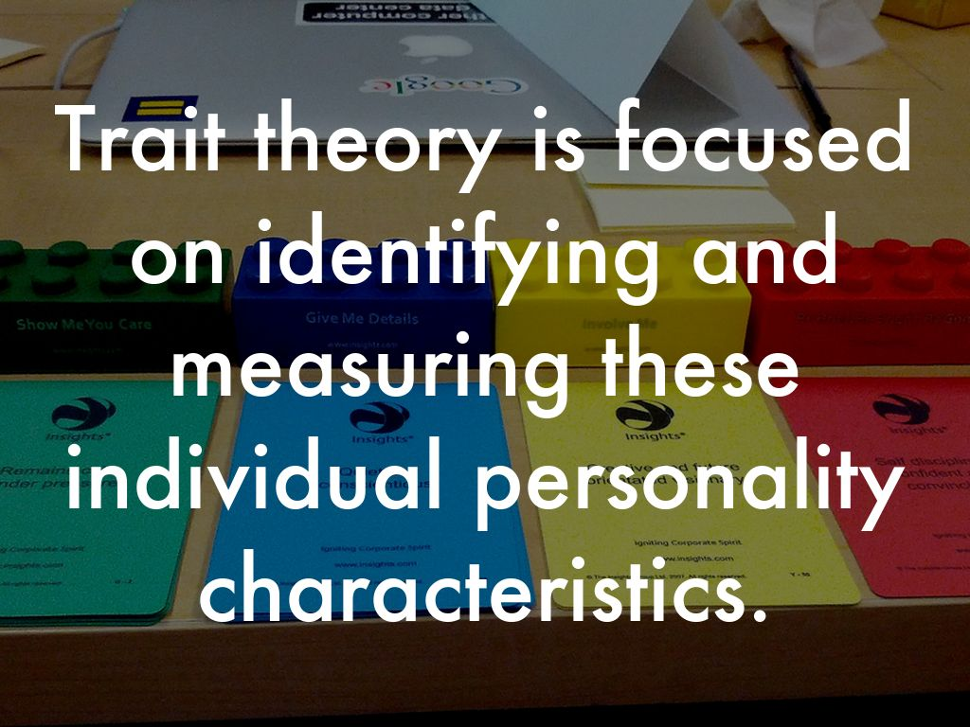
Photo by Photographing Travis - Creative Commons Attribution License https://www.flickr.com/photos/94599716@N06
Created with Haiku Deck

Slide 8
TRAIT THEORIES of personality focus on individual differences between people rather than similarities:
TRAITS refer to those unique and enduring characteristics of people that predispose them to behave in certain ways. They can be identified, described and measured.
Surface Traits: can easily be inferred from behaviour, eg happy, tearful.
Source Traits: represent the main basic dimensions of personality
EYSENCK considered that there were three main dimensions of personality:
INTROVERSION-EXTRAVERSION;
NEUROTICISM-STABILITY;
PSYCHOTICISM.

Slide 9
He derived 4 basic personality types from the first two main dimensions:
Introverted-neurotic, with surface traits such as moody, anxious, reserved and rigid.
Extraverted-neurotic, with surface traits like aggression, impulsive and excitable.
Extraverted-stable, characterised by a person being outgoing, talkative and lively.
Introverted-stable, with surface traits such as passive, controlled, reliable and calm.

Slide 10
EYSENCK: Personality differences reflect biological differences: supporting evidence through recent brain imaging
BEHAVIOURAL GENETICS: (Twin and adoption studies) Comparing and contrasting identical twins either to each other or to their parents. Also adopted children and their unrelated family members.
These studies have shown that heredity seems to play a role in four of the Big Five personality traits of extraversion, neuroticism, openness to experience and conscientiousness (but not agreeableness)
Genetics do not explain all of personality; environment plays an equal role. Seen in identical twins who are reared together – show similar personalities but years later after different experiences in adulthood display different personality traits.

Slide 11
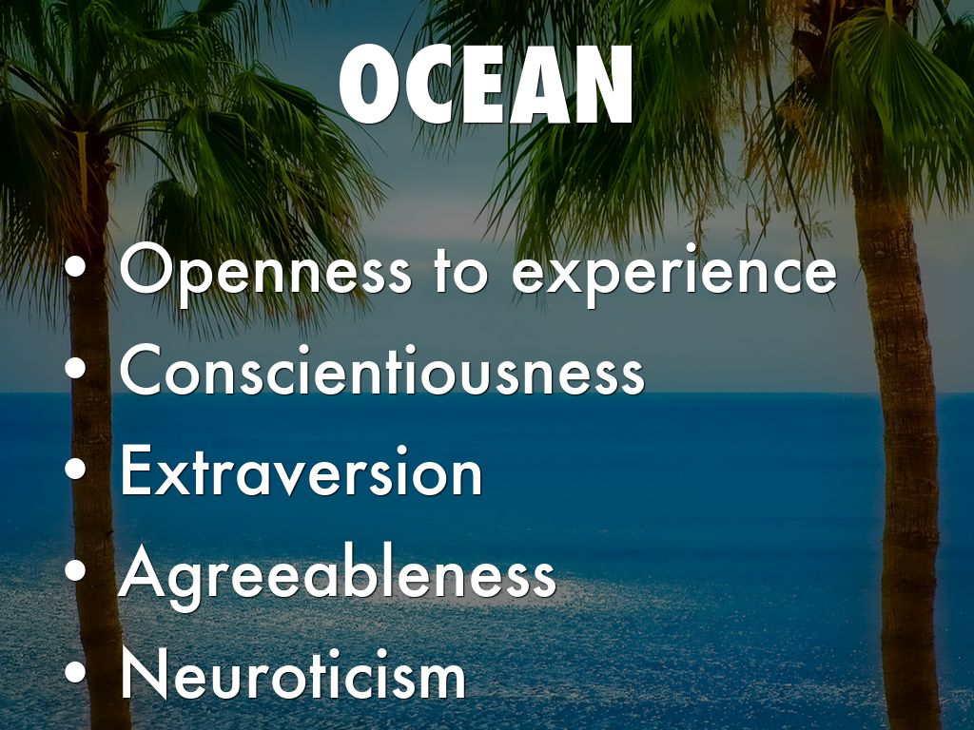
Photo by Thomas Tolkien - Creative Commons Attribution License https://www.flickr.com/photos/38585972@N04
Created with Haiku Deck

Slide 12

TRAIT THEORY
The five-factor theory of personality by McCrae and Costa (1997) is the most recent addition to trait theory. They believe in five core dimensions:
Openness to Experience–creative & willing to try new things
Conscientiousness – reliable, responsible, thorough, dependable, hard-working
Extraversion – outgoing, social, active, talkative
Agreeableness – easy to get along with, pleasant, sympathetic, warm, cooperative
Neuroticism – emotional stability
Acronym: OCEAN

Slide 13
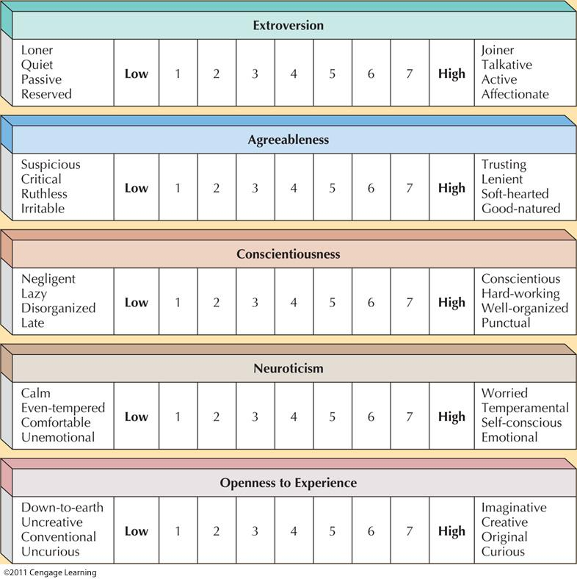
Notes:
13

Slide 14
EXAMPLES OF PERSONALITY TESTS
NEO Five Factor Inventory (NEO-FFI)
Full sentences, 240 items
(Costa & McCrae , 1988)
Big Five Inventory (BFI)
Short phrases, 44 items
(John & Srivastava, 1999)
Trait Descriptive Adjectives TDI
100 trait-descriptive adjectives
(Goldberg, 1992)

Slide 15
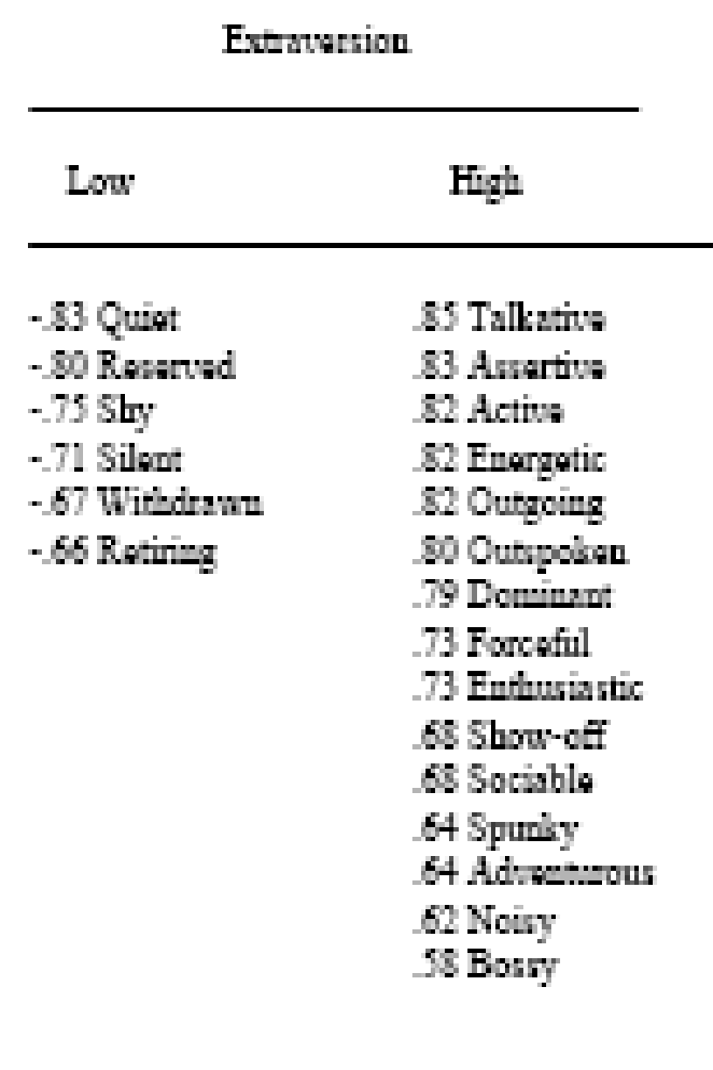
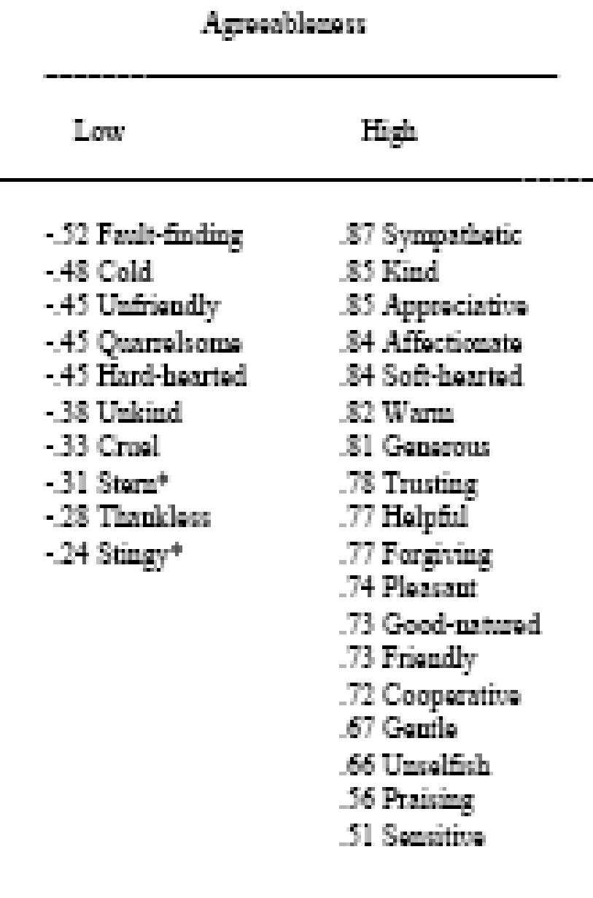
EXTRAVERSION AND AGREEABLENESS

Slide 16
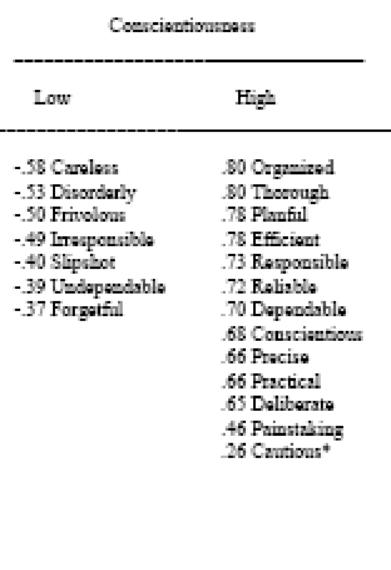
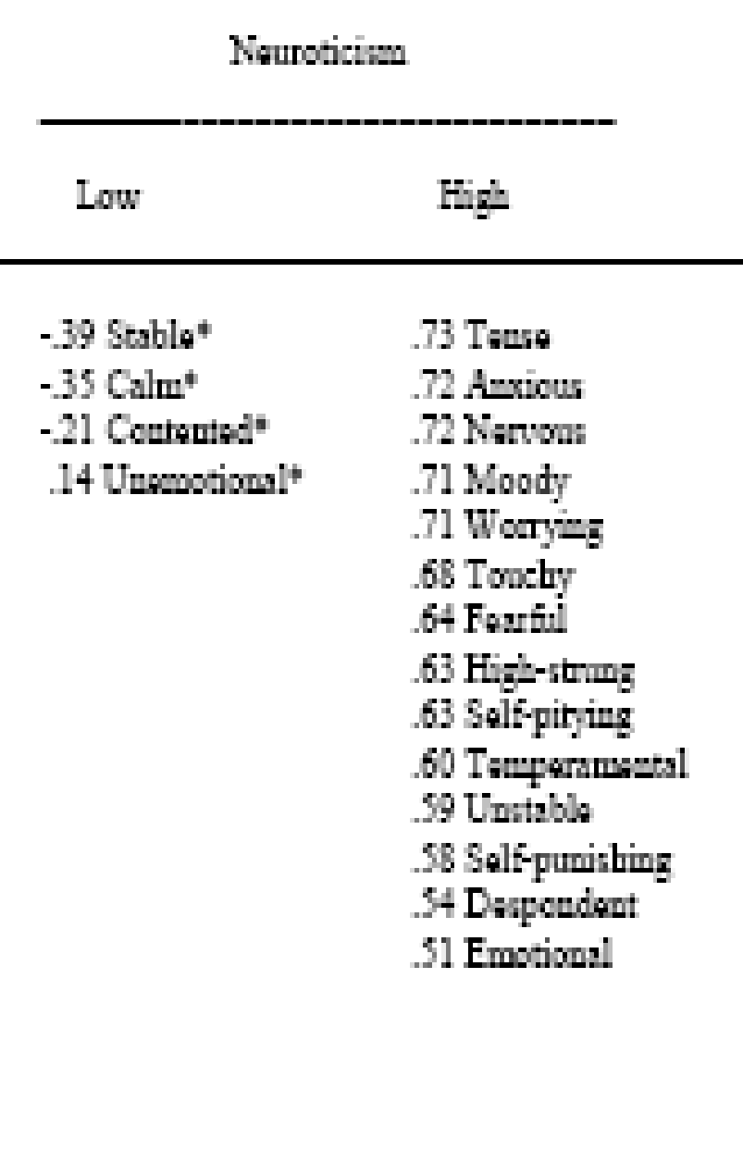
CONSCIENTIOUSNESS AND NEUROTICISM

Slide 17
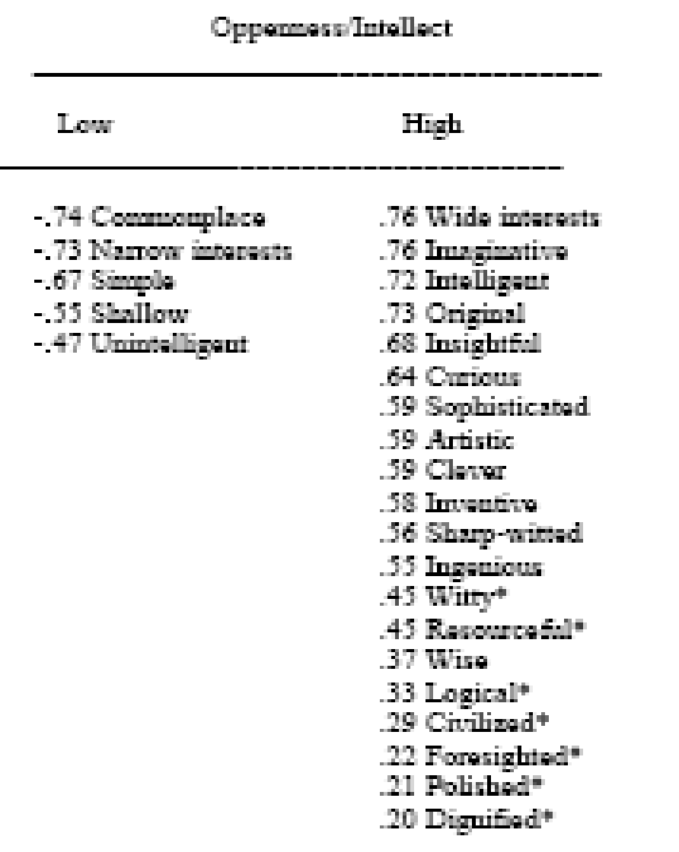
OPENNESS

Slide 18
Trait theories have widespread acceptability in psychology and continue to contribute to research on personality development.
THREE CRITICISMS OF TRAIT THEORIES:
It has been claimed that the traits identified are NOT personality BUT simply predispositions to behave in certain ways in different situations.
Saying that some of our personality is inherited and some the result of environmental influence does not really tell us very much about the nature and development of individual differences in personality.
Trait theories fail to take into account unconscious processes, beliefs and motives that may influence personality and may be useful in descriptions of development and change in personality

Slide 19
CRITICISMS OF THE “BIG FIVE”
Most of the other four factors generalize across cultures and countries, but the fifth factor (openness to experience) is usually the dimension that varies
In Netherlands, their ‘openness to experience’ emphasized unconventionality and rebelliousness, rather than intellect and imagination (as in ours)

Slide 20
While McCRAE & COSTA thought there were five:
EXTRAVERSION, NEUROTICISM, OPENNESS TO EXPERIENCE, AGREEABLENESS & CONSCIENTIOUSNESS.
MICHAEL ASHTON added a 6th factor: HONESTY-HUMILITY.
All trait theories claim that these “personality traits” are stable, enduring characteristics. It is also believed that our biological make-up (Genetics) plays a major role in determining our personality. There is evidence in adoption studies that our genes do play an important role in personality development.

Slide 21
THE BIG 5 AND JOB PERFORMANCE
Barrick, M. R., & Mount, M. K. (1991). The Big Five personality dimensions and job performance: A meta-analysis. Personnel Psychology, 44 (1), 1-26.
C showed consistent relations with all job performance criteria for all occupational groups
E predicted success in management and sales (requiring social interaction)
O and E predicted training proficiency
A and N predict performance when employees work in groups

Slide 22
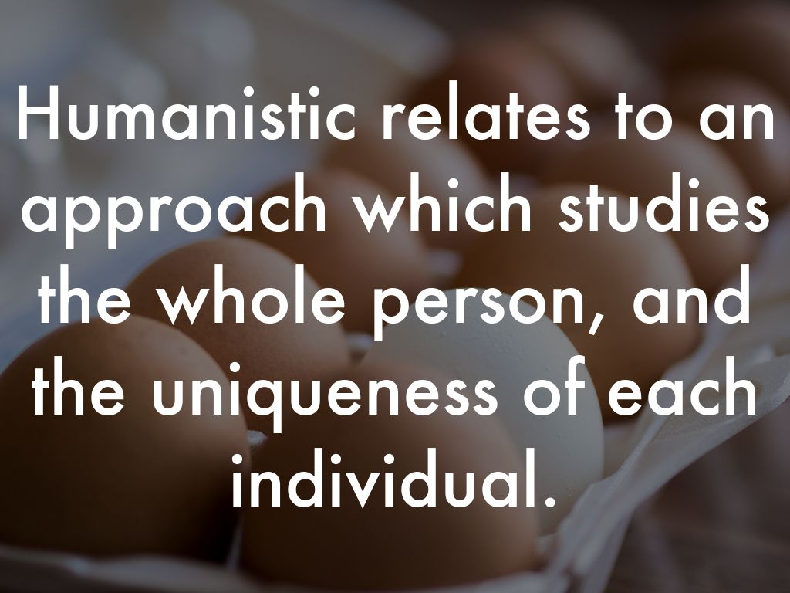
Photo by Robert S. Donovan - Creative Commons Attribution-NonCommercial License https://www.flickr.com/photos/10687935@N04
Created with Haiku Deck

Slide 23
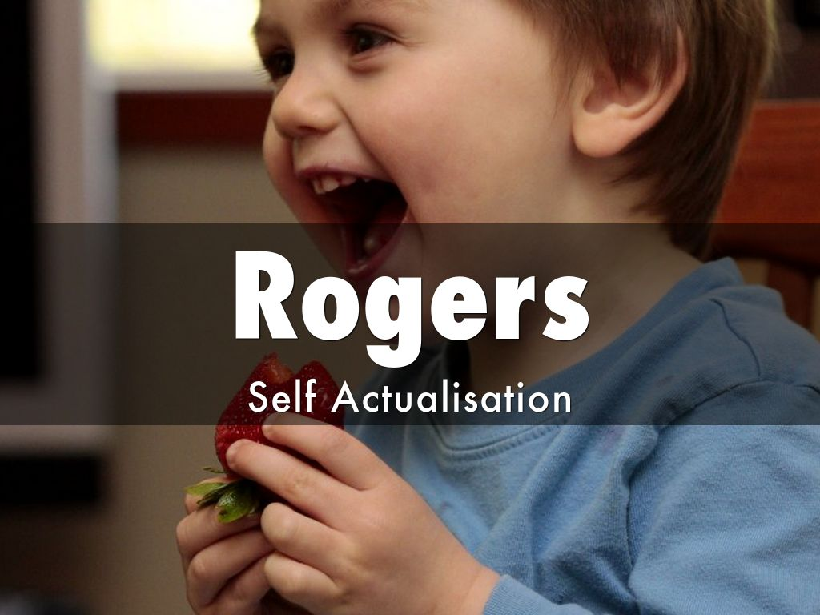
Photo by sean dreilinger - Creative Commons Attribution-NonCommercial-ShareAlike License https://www.flickr.com/photos/43927576@N00
Created with Haiku Deck

Slide 24
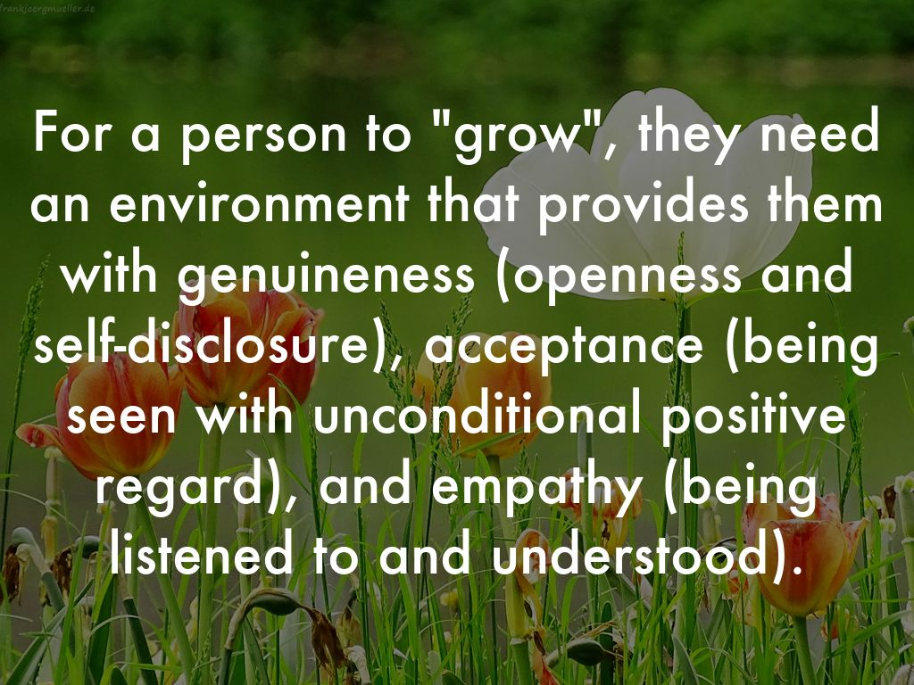
Photo by Ranger56112 - Creative Commons Attribution-NonCommercial License https://www.flickr.com/photos/83820802@N02
Created with Haiku Deck

Slide 25
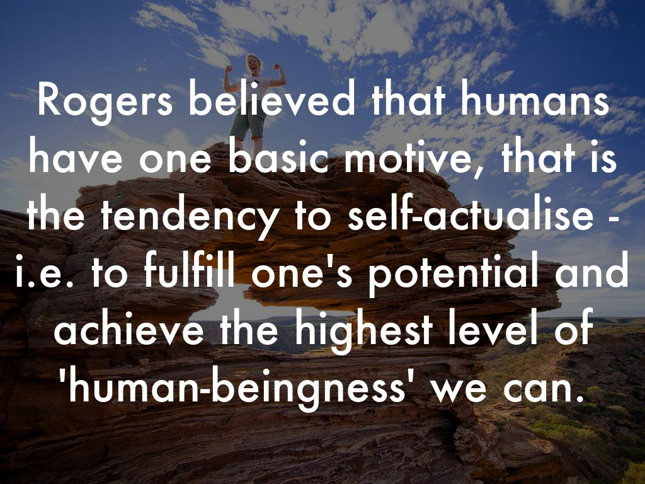
Photo by drubuntu - Creative Commons Attribution-NonCommercial-ShareAlike License https://www.flickr.com/photos/51980416@N03
Created with Haiku Deck

Slide 26
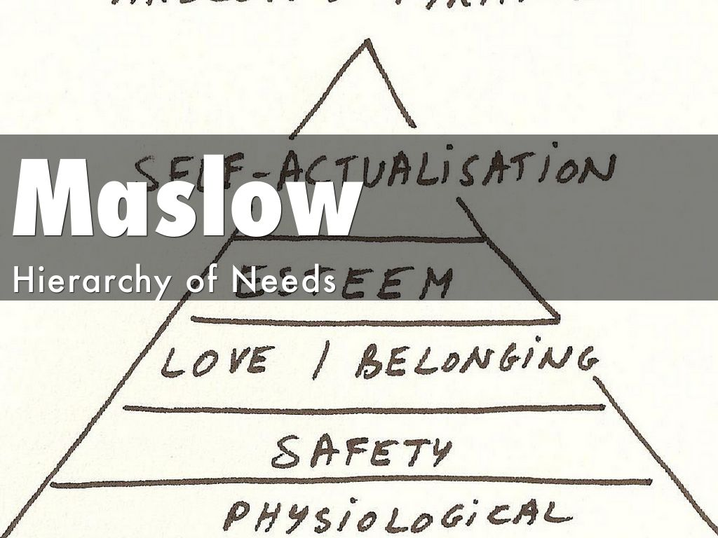
Photo by Luc Galoppin - Creative Commons Attribution License https://www.flickr.com/photos/7572628@N03
Created with Haiku Deck

Slide 27
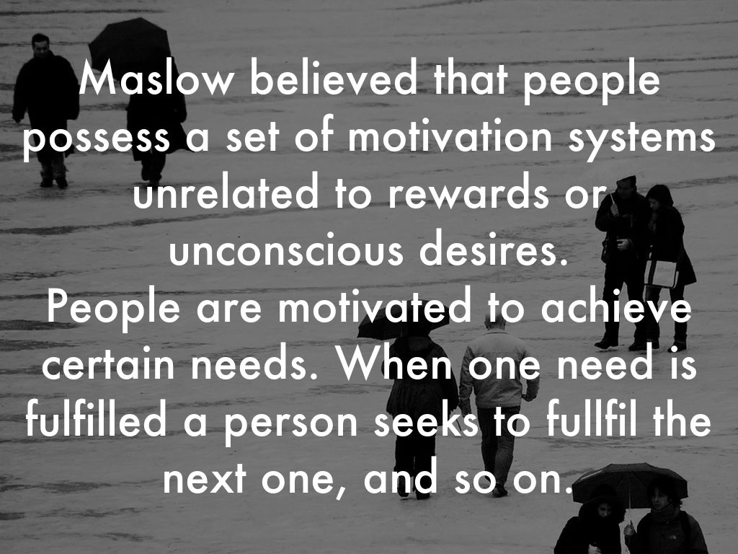
Photo by bachmont - Creative Commons Attribution License https://www.flickr.com/photos/8845870@N07
Created with Haiku Deck

Slide 28
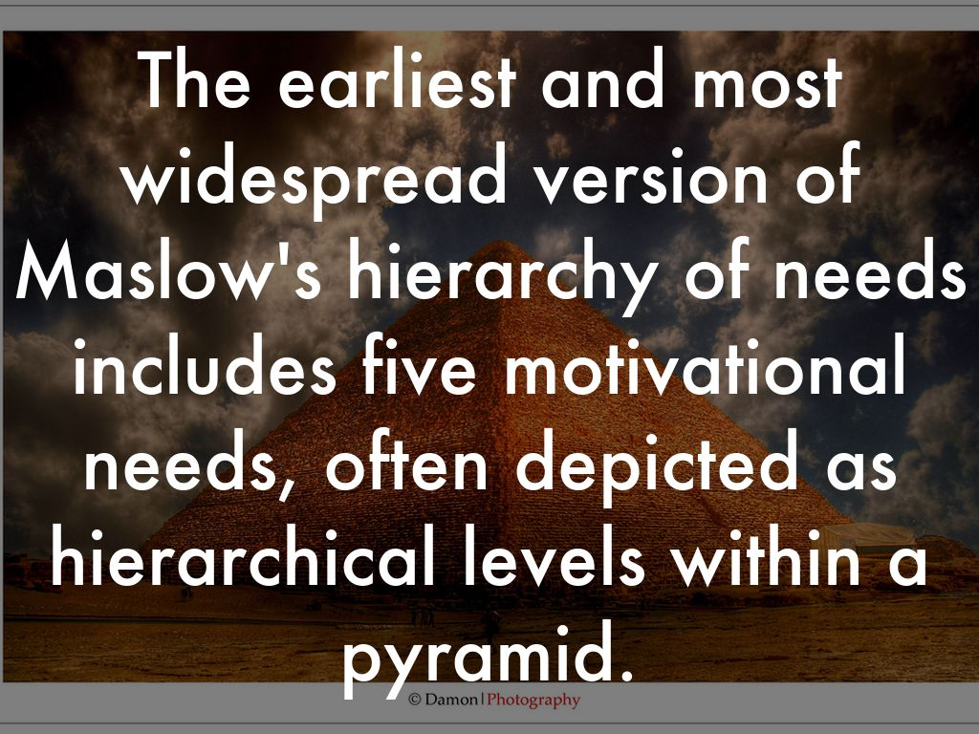
Photo by Damon | Photography - Creative Commons Attribution-NonCommercial-ShareAlike License https://www.flickr.com/photos/9906699@N07
Created with Haiku Deck

Slide 29
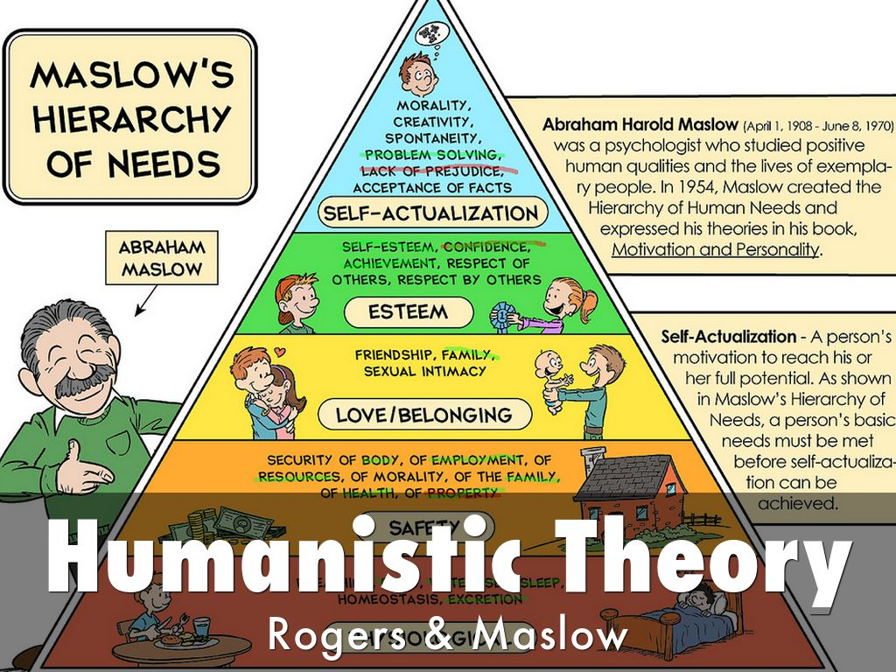
Photo by cesarharada.com - Creative Commons Attribution-NonCommercial-ShareAlike License https://www.flickr.com/photos/27703797@N06
Created with Haiku Deck

Slide 30
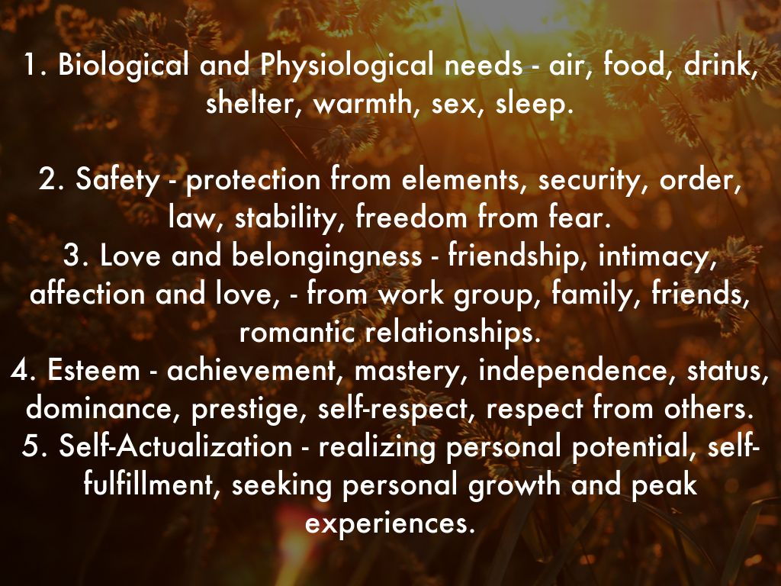
Photo by Geraint Rowland Photography - Creative Commons Attribution-NonCommercial License https://www.flickr.com/photos/33909206@N04
Created with Haiku Deck

Slide 31
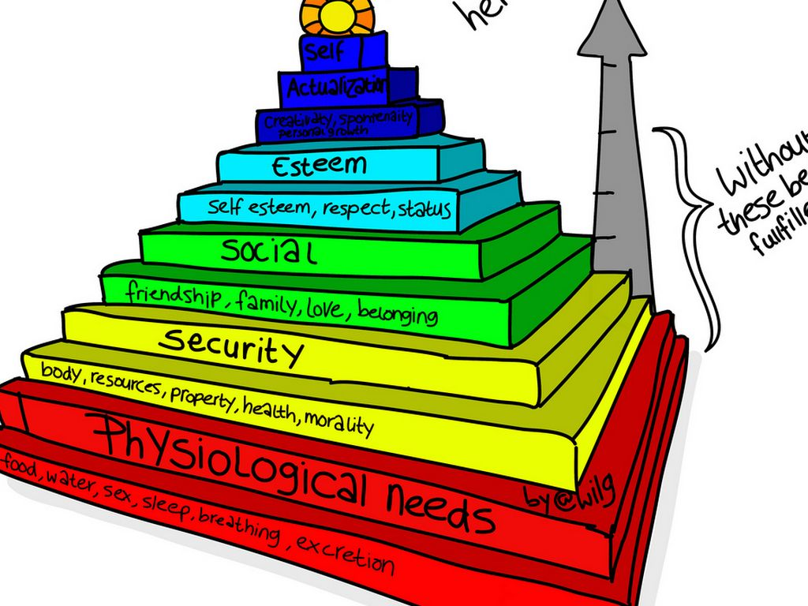
Photo by wilgengebroed - Creative Commons Attribution-NonCommercial License https://www.flickr.com/photos/82655797@N00
Created with Haiku Deck

Slide 32
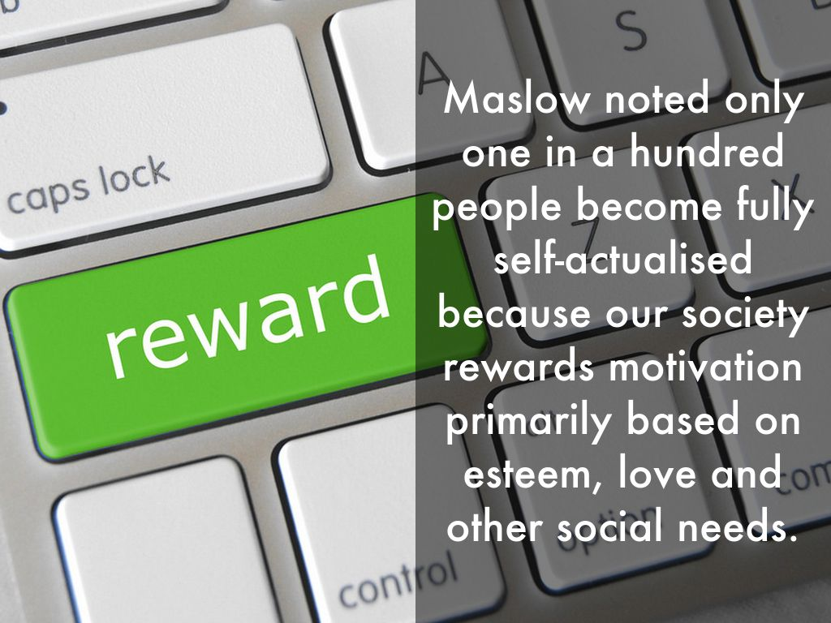
Photo by GotCredit - Creative Commons Attribution License https://www.flickr.com/photos/30576334@N05
Created with Haiku Deck

Slide 33
Humanistic psychology has been influential in psychotherapy, education, parenting and business.
It has been criticised on two points:
Humanistic theories are hard to test scientifically; they are based on clinical observation (cases) or philosophical assumptions rather than empirical research. Concepts like the ‘actualising tendency’ and ‘positive regard’ are difficult to observe, measure and study objectively.
The fundamental basic premise that humans are inherently good may be too optimistic or naïve.

Slide 34
HUMANISTIC THEORIES: Focused on healthy personalities
They regarded people as inherently good and based this on the belief that people grow psychologically from within and are motivated to do so.
The main criticism is that the Theory as a whole cannot be tested. (open to dispute)
Not all will agree that people are motivated by a need for personal growth and are striving to achieve their potential.
Also a major concern is the vagueness of concepts such as “self-actualisation.’ Vague concepts are very difficult to investigate scientifically

Slide 35
Other criticisms of Maslow’s theory:
Critics suggested that his descriptions of characteristics of a self-actualised person were simply a list of HIS OWN values of persons studied. (Subjective viewpoint)
Critics also said that his theories are overly optimistic and fail to take into account the human capacity for evil.
We need to acknowledge BOTH good and evil in the world if we are to be realistic.

Slide 36
CONSISTENCY IN PERSONALITY: CONTINUITY IN PERSONALITY OVER TIME:
There is considerable research evidence to indicate that once adulthood is reached personality is largely stable, BUT the specific age at which personality stabilises is varied.
Studies indicate that adolescents are very similar to young adults in the stability of their personality traits at individual level.
They also found that by the age of 16 the adolescents had reached the rank-order stability typical of young adults.
Rank Order of stability – stability in personality relative to all others in the population, keeping their individual ranking in a group (measurement of introversion in relation to others)

Slide 37
CONSISTENCY OF PERSONALITY ACROSS SITUATIONS.
If we consistently report our personality in such a way that we score high on conscientiousness & agreeableness, does this mean that we will behave in a cheerful and helpful way regardless of the task we are doing or the company we are in???
Research indicates that this is NOT necessarily the case.
Walter Mischel (1984) found that conscientiousness in college students could ONLY be predicted with a moderate degree of success. He found that scores on personality tests only mildly predicted behaviour. It is unfair to expect personality traits to predict behaviour on every specific occasion as other factors do come into play. (read pages 238-239)

Slide 38
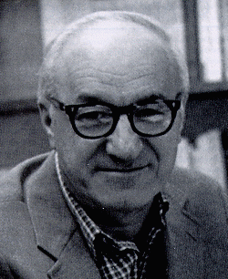
Social Cognition
Bandura proposed two factors as the major components of relatively permanent change:
Context
Beliefs
There is a similar relationship between:
Piaget and Information Processing
Vygotsky and Social Cognition

Slide 39
Social Cognition
Bandura developed the concept of reciprocal determinism to account for human behaviour.
OVERT BEHAVIOUR
PERSONAL FACTORS
ENVIRONMENT

Slide 40
Social Cognition
Bandura believes that human beings have specific abilities and that only reciprocal determinism can explain their operation and interaction:
Model and imitate
Self-reflect
Regulate own behaviour

Slide 41
Self-Efficacy
Self-reflection is a second human quality and is expressed in the concept of self-efficacy.
“Self-efficacy is the belief in one’s capabilities to organize and execute the sources of action required to manage prospective situations.” (Bandura, 1986)

Slide 42
Self-Efficacy
Self-efficacy impacts:
The choices we make
The effort we put forth
How long we persist when we confront obstacles (especially in the face of failure)
How we feel about ourselves, others, the task, etc.

Slide 43
Self-Efficacy
Self-efficacy is influenced by:
Mastery experiences
Vicarious experiences - vicarious reinforcement is our tendency to repeat or duplicate behaviours for which others are being rewarded.
Social persuasions
Physiological states

Slide 44
Social Cognition
Bandura’s basic position is that
“People's level of motivation, affective states, and actions are based more on what they believe than on what is objectively the case.”

Slide 45
Introduction to Mischel’s Personality Theory
Early work objected to trait theory explanation of behaviour
Cognitive activities and specific situations play role in determining behaviour
Recently have advocated reconciliation between processing dynamics and personal dispositions approaches
Holds that behaviour stems from relatively stable personal dispositions and cognitive-affective processes interacting with a particular situation

Slide 46
Background of the Cognitive-Affective Personality System
Consistency Paradox
Although both laypeople and professionals tend to believe that behavior is quite consistent, research suggests that it is not
Person-Situation Interaction
Mischel believes that behavior is best predicted from an understanding of the person, the situation, and the interaction between person and situation

Slide 47
Cognitive-Affective Personality System
Behaviour Prediction
Individuals should behave differently as situations vary
Situation Variables
All those stimuli that people attend to in a given situation
Cognitive-Affective Units
Encoding strategies
Competencies and self-regulatory strategies
Expectancies and beliefs
Goals and values
Affective responses

